Slide 1

Week 1
Task Based Placement Preparation Program(TBPPP) GLA University, Mathura

Slide 2
Topics covered this week
Understanding time and space complexity (Big O notation).
Recurrence Relations

Slide 3


Significance and Applications
Real-Life Applications of Asymptotic Analysis and Recurrence Relations
Algorithm Design and Optimization
Analyze time and space complexity to ensure efficient performance.
Optimize recursive algorithms using recurrence relations.
Network and System Efficiency
Evaluate server response times for scalable system design.
Optimize data packet routing in communication networks.
Modeling and Forecasting
Develop iterative models in machine learning and AI.
Predict future trends in finance and resource allocation.

Slide 4
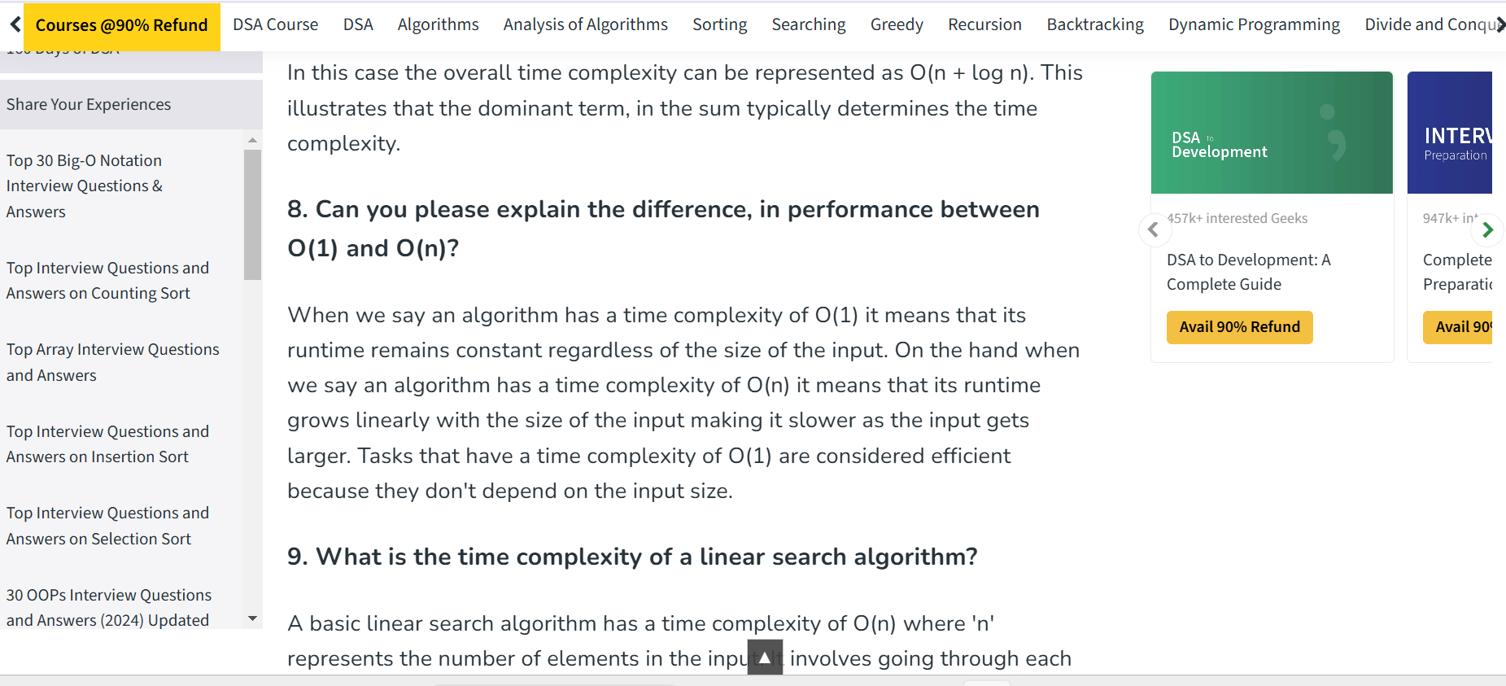
Placement Insights and Interview Relevance

Slide 5
Interactive Quiz and Knowledge Check
Algorithm test

Slide 6
Asymptotic Analysis of Algorithms

Slide 7
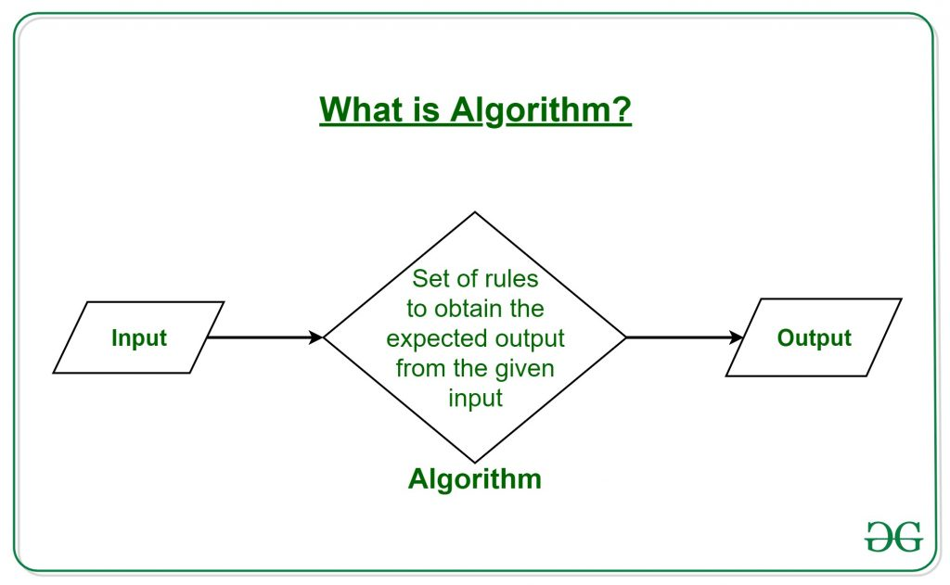
What is Algorithm?
A procedure for solving a mathematical problem in a finite number of steps

Slide 8
Types of Algorithms:
Brute Force Algorithm
Recursive Algorithm
Backtracking Algorithm
Searching Algorithm
Sorting Algorithm
Hashing Algorithm
Divide and Conquer Algorithm
Greedy Algorithm
Dynamic Programming Algorithm
Randomized Algorithm

Slide 9
Asymptotic Notations
In mathematics, asymptotic analysis, also known as asymptotics, is a method of describing the limiting behavior of a function.
Asymptotic analysis of an algorithm refers to defining the mathematical boundation of its run-time performance based on the input size
f(n) = c: This means the running time will be independent of the input size
f(n) = n : This means the running time will increase linearly with the increase in n.

Slide 10
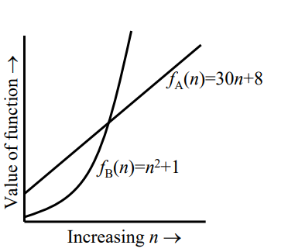
Growth of Functions
If f(x) is faster growing than g(x), then f(x) always eventually becomes larger than g(x) in the limit (for large enough values of x).

Slide 11
Analysis of an algorithm is done based on three cases:
Best Case (Omega Notation (Ω))
Average Case (Theta Notation (Θ))
Worst Case (O Notation(O))

Slide 12
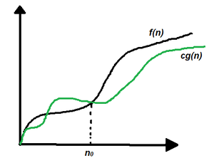
Omega Notation(Lower Bound)
f(n) = Ω(g(n)), If there are positive constants n0 and c such that, to the right of n0 the f(n) always lies on or above c*g(n).
f(n) >= c.(g(n)

Slide 13
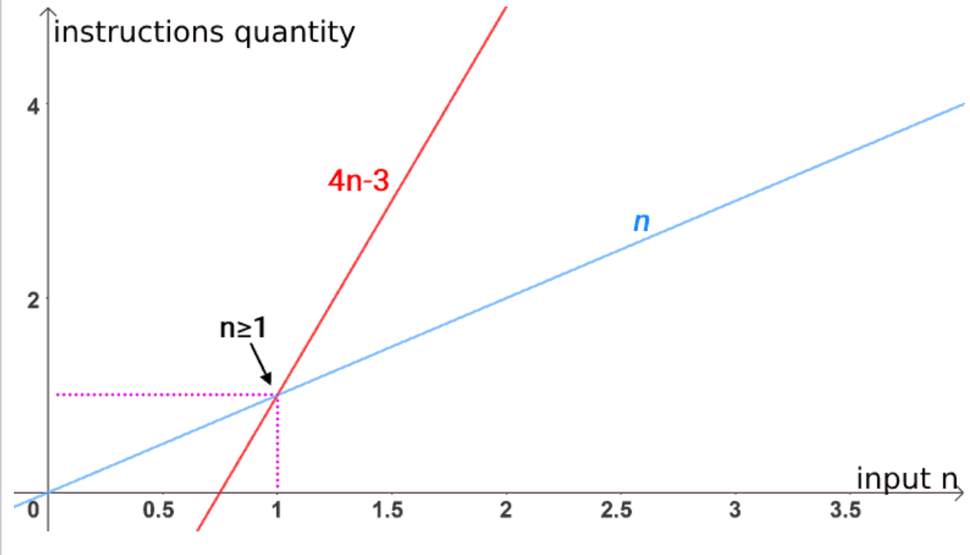
Omega example, Graphically
When we say that the 4n-3 function is Ω(n) (read “is omega of n”), we are saying that the asymptotic behavior of a linear function is equal to or less than its own.
That is to say: the 4n-3 function will never have a growth behavior inferior to that of a function with linear behavior.

Slide 14
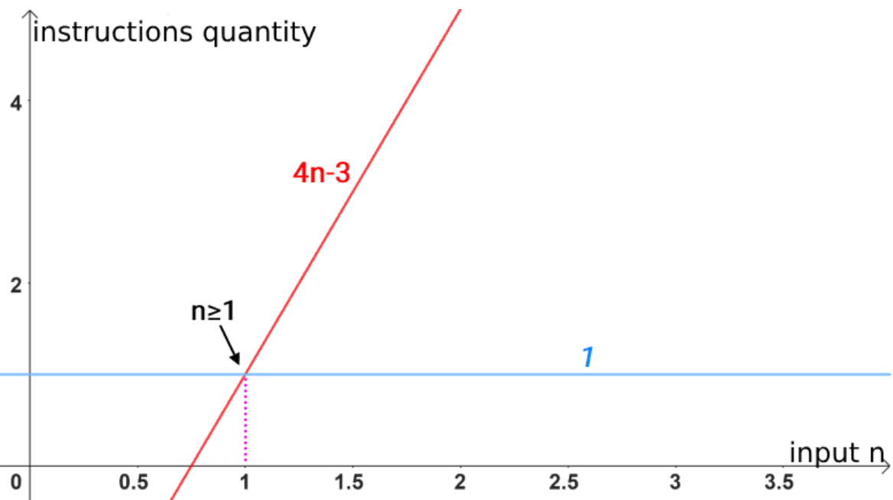
4n-3 is Ω(1), as the function 4n-3 will never show a growth behavior that is surpassed by a constant behavior.
Thus, Ω(1) also presents itself as a lower asymptotic limit:

Slide 15
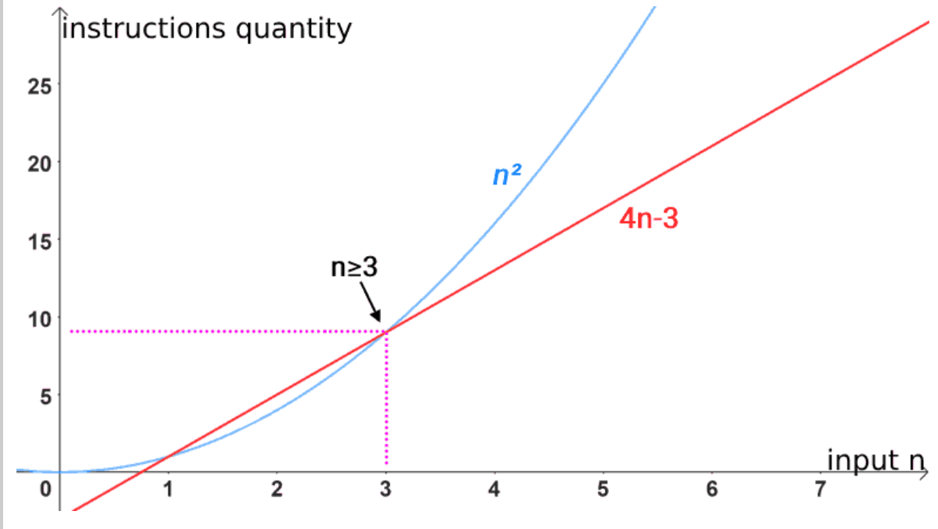
4n-3 is Ω(n²), as the function 4n-3 will never grow to the point of overcoming quadratic behavior.
In this way, Ω(n²) is not presented as an lower asymptotic limit:

Slide 16
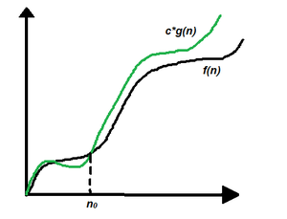
Big-O Notation(Upper Bound)
f(n) = O(g(n)), If there are positive constants n0 and c such that, to the right of n0 the f(n) always lies on or below c*g(n).
f(n) <= c*(g(n))

Slide 17
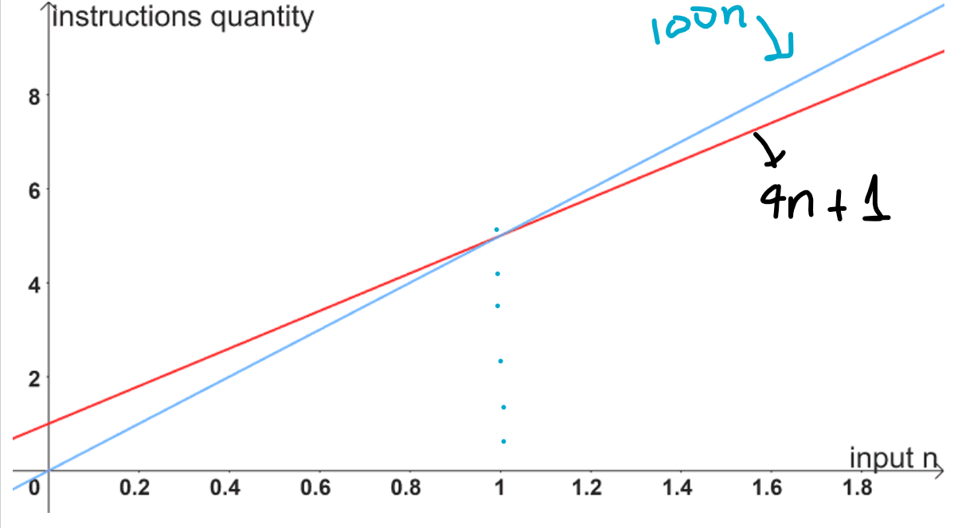
Big-O example, graphically
When we say that the linear function 4n+1 is O(n), we are saying that: “the asymptotic behavior of a linear function is equal to or greater than its“.
It means to say: the function 4n+1 will never grow to the point of surpassing the linear behavior.

Slide 18
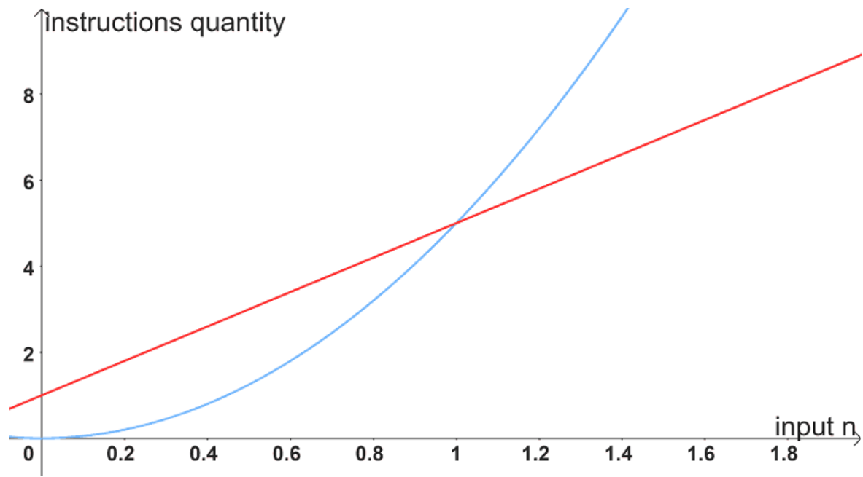
Big-O example, graphically
Likewise, it is also correct to state that the linear function 4n+1 is O(n²), as the function 4n+1 will never grow to the point of surpassing the quadratic behavior.
Therefore, O(n²) also presents itself as an upper asymptotic limit:

Slide 19
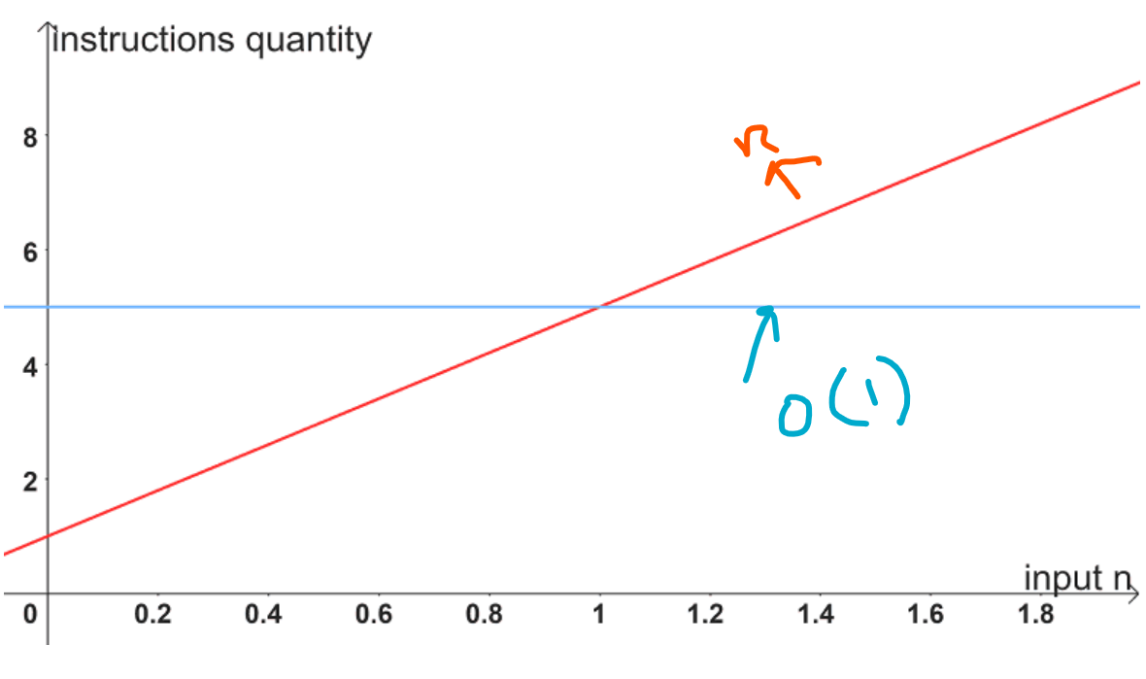
Big-O example, graphically
On the other hand, it would be wrong to say that the linear function 4n+1 is O(1), because the function 4n+1 will always grow to the point where it exceeds the constant behavior.
In this way, O(1) does not present itself as an asymptotic upper bound:

Slide 20
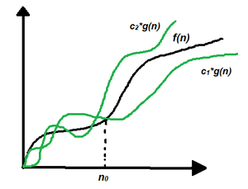
Theta Notation
f(n) = Θ(g(n)), If there are positive constants n0 and c such that, to the right of n0 the f(n) always lies on or above c1*g(n) and below c2*g(n)
c1*g(n) <= f(n) <= c2*g(n)

Slide 21
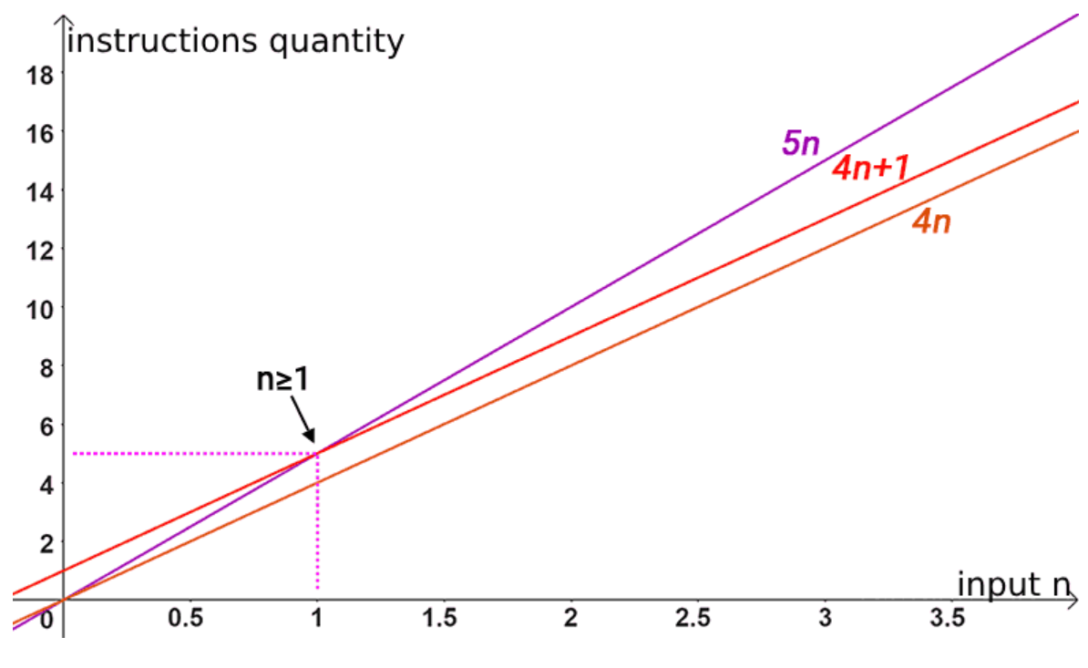
Theta example, graphically
First, we have to:
f(n) = 4n+1
g(n) = n
This holds true 4n+1=Θ(n)!! So, for this problem, we need to show that:
c₁.n ≤ 4n+1 ≤ c₂.n for all n ≥ n₀.

Slide 22
What does ‘Space Complexity’ mean?
Auxiliary Space is the extra space or temporary space used by an algorithm
The space Complexity of an algorithm is the total space taken by the algorithm with respect to the input size
Space complexity includes both Auxiliary space and space used by input.

Slide 23
Recurrence Relations

Slide 24
What is Recurrence Relations?
A recurrence relation is a mathematical expression that defines a sequence in terms of its previous terms
In the context of algorithmic analysis, it is often used to model the time complexity of recursive algorithms.

Slide 25
What is Linear Recurrence Relation?
In a linear recurrence relation, each term in the sequence is a linear combination of previous terms.
General form: where, c1, c2, …, ck are constants and F(n) is a function.

Slide 26
How to Solve Recurrence Relations?
Substitution Method
Recurrence Tree Method
Master Method

Slide 27
Substitution method
T(n) = T(n-1) + n for n > 0 and T(0) = 1
T(n) = T(n-1) + n
= T(n-2) + (n-1) + n
= T(n-3) + n-2 + n - 1 + n + 1
= T(n-4) + n-3 + n-2 + n-1 + n + 1
| | |
= T(n-k) + (n-(k-1))….. (n-1) + n

Slide 28
T(n-k) + (n-(k-1))….. (n-1) + n
Substituting k = n, we get
T(n) = T(0) + 1 + 2+….. +n = n(n+1)/2 = O(n^2)

Slide 29
Example 2
T(n) = T(n/2) + 1 where T(n) is the time required for binary search in an
array of size n
0st step=> T(n)=T(n/2) + 1
1nd step=> T(n)=T(n/4) + 1 + 1 [ T(n/4)= T(n/2^2) ]
2rd step=> T(n)=T(n/8 ) + 1 + 1 + 1 [ T(n/8)= T(n/2^3) ]
3th step=> T(n)=T(n/16 ) + 1 + 1 + 1 [ T(n/16)= T(n/2^4) ]
| | |

Slide 30
Contd.
kth step=> T(n/2^k)=T(n/2^k-1) + 1*(k times)
n=2^k
=> log n=k [taken log(base 2) on both sides ]
T(n) = T(1) + 1 + 1 + 1 + 1 … log n times
T(n) = T(1) + log n
T(n) = O(log n)

Slide 31
2. Recurrence Tree Method
In this method, we draw a recurrence tree and calculate the time taken by every level of the tree. Finally, we sum the work done at all levels.
For example, consider the recurrence relation
T(n) = T(n/4) + T(n/2) + c(n^2)

Slide 32
c(n^2)
/ \
T(n/4) T(n/2)
If we further break down the expression T(n/4) and T(n/2),
we get the following recursion tree.

Slide 33
c(n^2)
/ \
c(n^2)/16 c(n^2)/4
/ \ / \
T(n/16) T(n/8) T(n/8) T(n/4)

Slide 34
Breaking down further gives us following
c(n^2)
/ \
c(n^2)/16 c(n^2)/4
/ \ / \
c(n^2)/256 c(n^2)/64 c(n^2)/64 c(n^2)/16
/ \ / \ / \ / \

Slide 35
To know the value of T(n), we need to calculate the sum of tree nodes level by level. If we sum the above tree level by level
we get the following series T(n) = c(n^2 + 5(n^2)/16 + 25(n^2)/256) + ….
The above series is a geometrical progression with a ratio of 5/16.
To get an upper bound, we can sum the infinite series. We get the sum as (n^2)/(1 – 5/16) which is O(n^2)

Slide 36
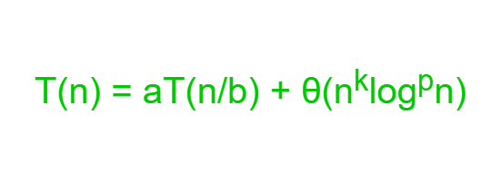
Master Method
where n = size of the problem
a = number of subproblems in the recursion and a >= 1
n/b = size of each subproblem
b > 1, k >= 0 and p is a real number

Slide 37
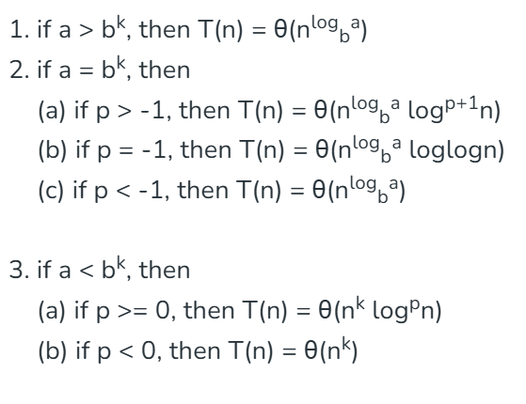
Then,

Slide 38
Example 1
T(n) = T(n/2) + O(1)
a = 1, b = 2, k = 0 and p = 0
b^{k} = 1. So, a = b^{k} and p > -1 [Case 2.(a)]
T(n) = θ(n^{log}_{b}ª log^{p+1}n)
T(n) = θ(logn)

Slide 39
Gate Questions
https://practicepaper.in/gate-cse/asymptotic-notation

Slide 40
Practice
https://www.geeksforgeeks.org/recurrence-relations-notes-for-gate-exam/

